Slide 1

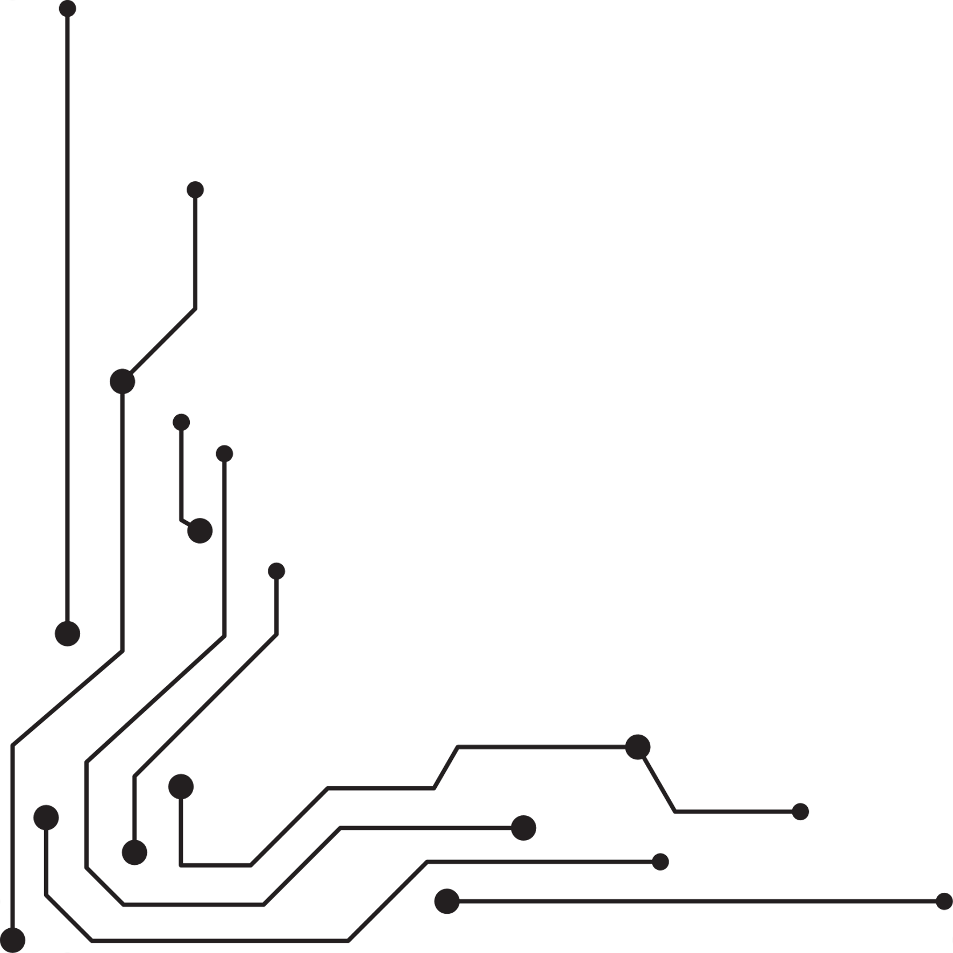
Aedhan | 3 Truths and 1 Lie
Aedhan is my middle name not my first name
I lived in Austria for a year
I have Canadian Citizenship
I've hiked up a volcano

Slide 2
AEDHAN
Types of Models and Capabilities

Slide 3
AEDHAN
Types of Models and Capabilities

Slide 4
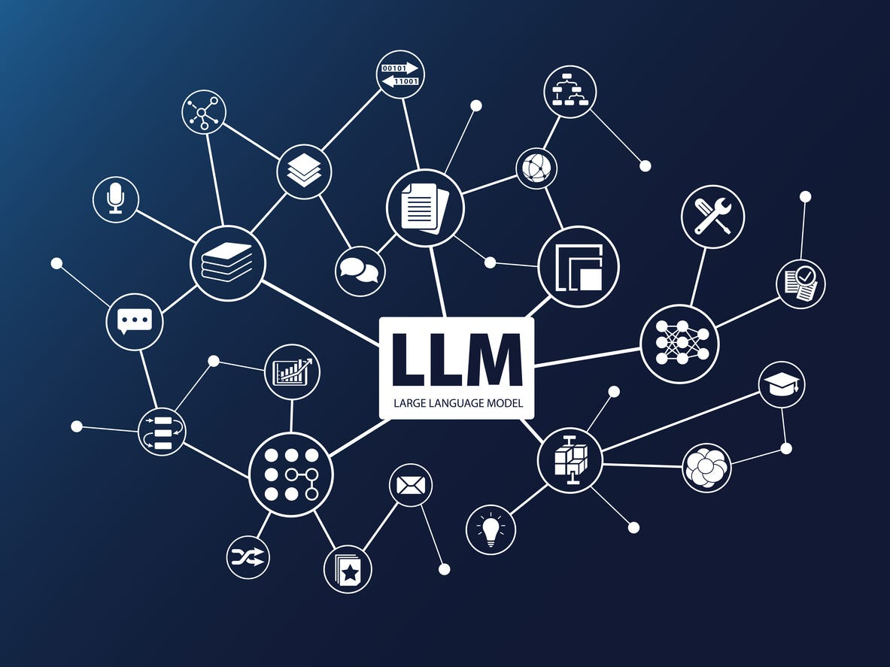



Text Based LLMs (Frontier Models)
Extensive and powerful Guardrails
Advanced features
Conversation Recall
Learns things about the user
Supports file upload
These are the models you've heard of before
(ChatGPT, Claude, Gemini)
The Big Three: Claude ChatGPT and Gemini

Slide 5
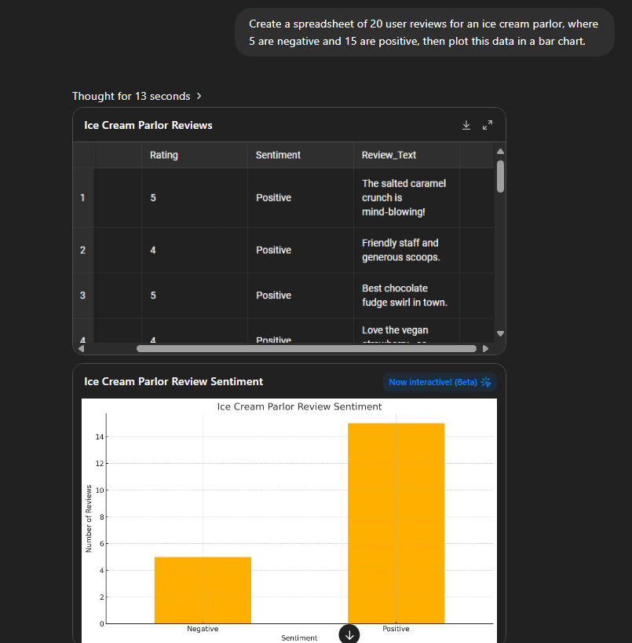

ChatGPT (o3)
Impressive Reasoning
Supports file upload
Runs Code Inline
Custom GPTs
Images and Video (with Sora)
Demo Time!
ChatGPT

Slide 6




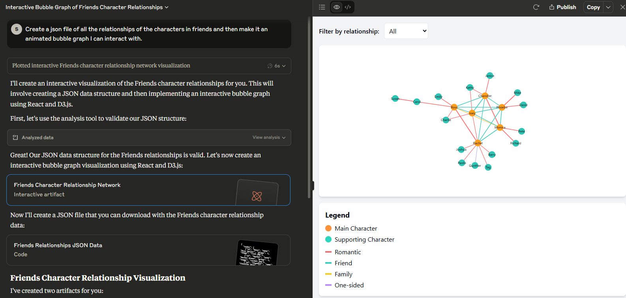
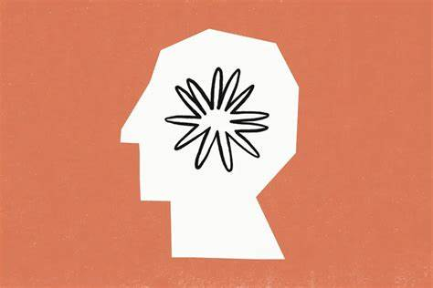
Anthropic's Claude
Enhanced Data Privacy and Security
Many similarities to chatGPT
Advanced visualization options

Slide 7
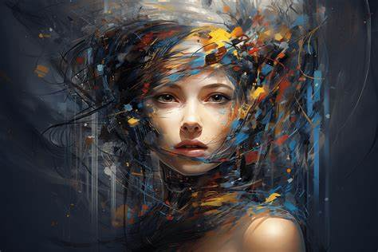

AI Image Generation

Slide 8
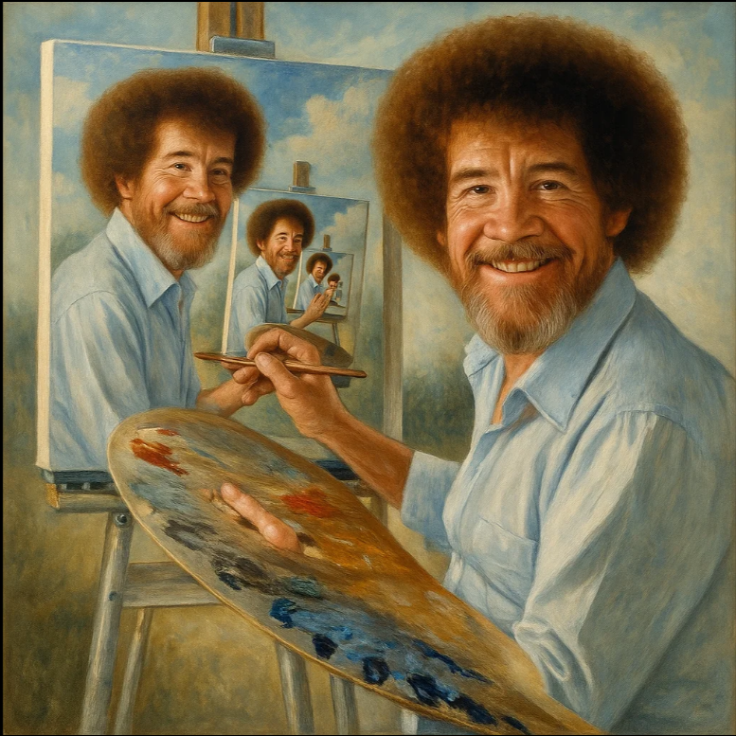
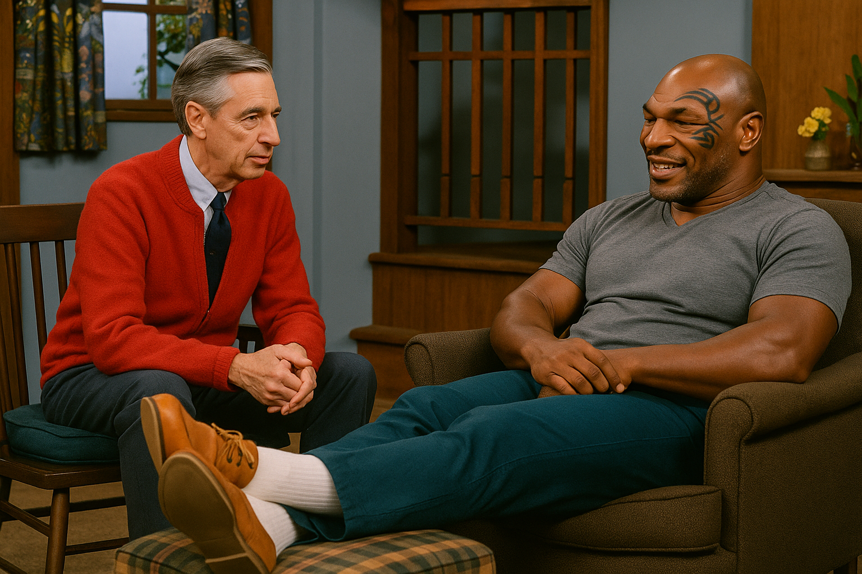
AI Image Models and Services
OpenAI's Sora
Simple/Short Prompts
Bob Ross painting a self portrait, which is painting a self portrait
Mr Rogers from Mr Rogers Neighborhood having a sitdown talk with Mike Tyson who has his feet up relaxing on an ottoman

Slide 9
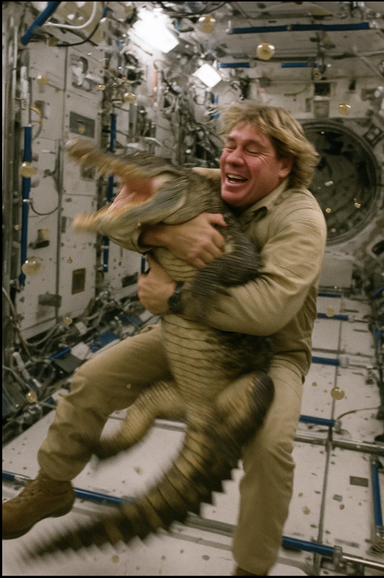
AI Image Models and Services
Demo Time!
https://sora.chatgpt.com/
OpenAI's Sora
Long, detailed prompts
Steve irwin in a tan colored space suit with no helmet grappling with a large crocodile on the ISS in zero g. The crocodile is trying to bite and claw at them but the astronaut is hugging it lovingly. The crocodile is motion blurred and thrashing. The astronaut is motion blurred. Stray perfectly spherical droplets of dirty water are floating everywhere near the camera man. Chaotic encounter. A Hastily taken, slightly blurry, unedited iPhone picture

Slide 10
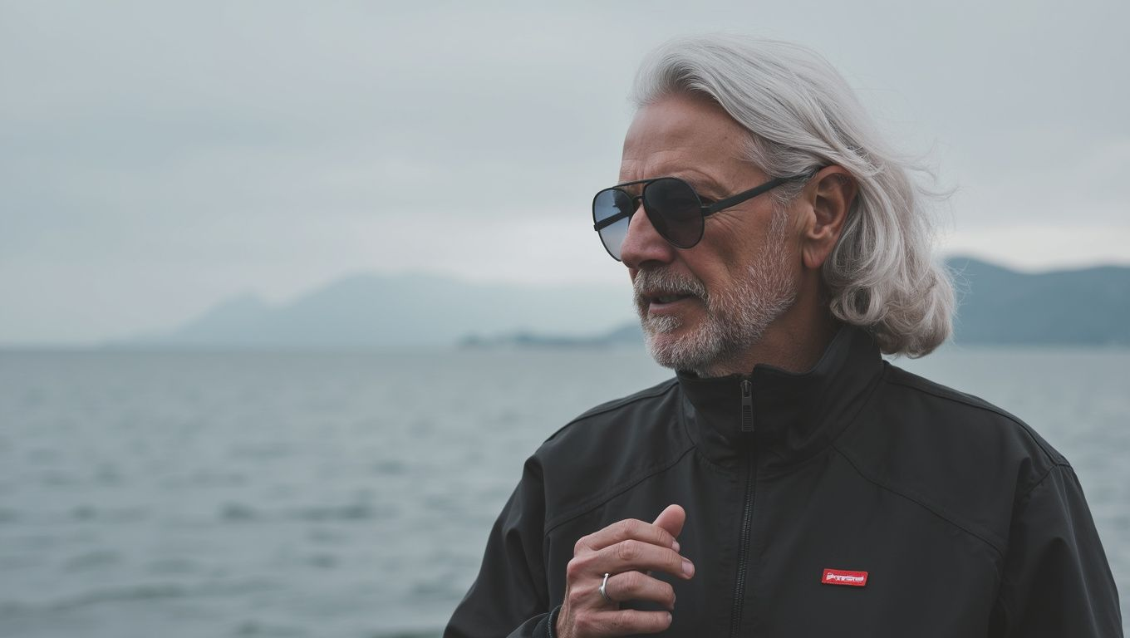
AI Image Models and Services
Black Forest Lab's Flux 1.1
Short Prompt
A person

Slide 11

AI Image Models and Services
Black Forest Lab's Flux 1.1
Long prompt
A side-angle, shallow depth-of-field image capturing the roasted rainbow carrots on a raised serving platter. The carrots glisten with olive oil and herbs, with crispy edges in focus and blurred golden kitchen fixtures in the background. The warm, natural light creates a slight glow on the marble surface, adding elegance and intimacy to the composition.

Slide 12
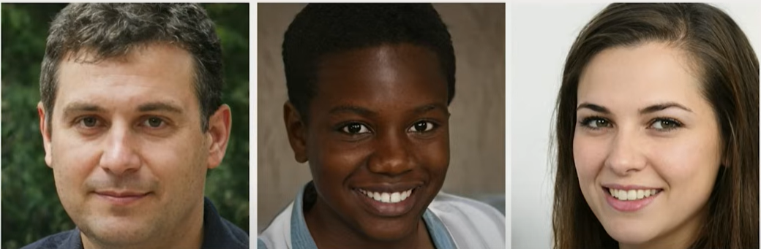
Which face is real?
A
B
C

Slide 13
This Person Does Not Exist - Random Face Generator

Slide 14
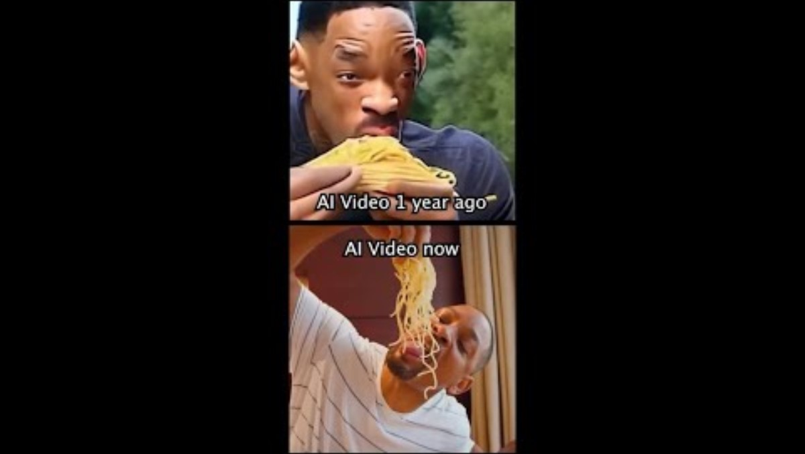
The Journey of AI Video Generation

Slide 15
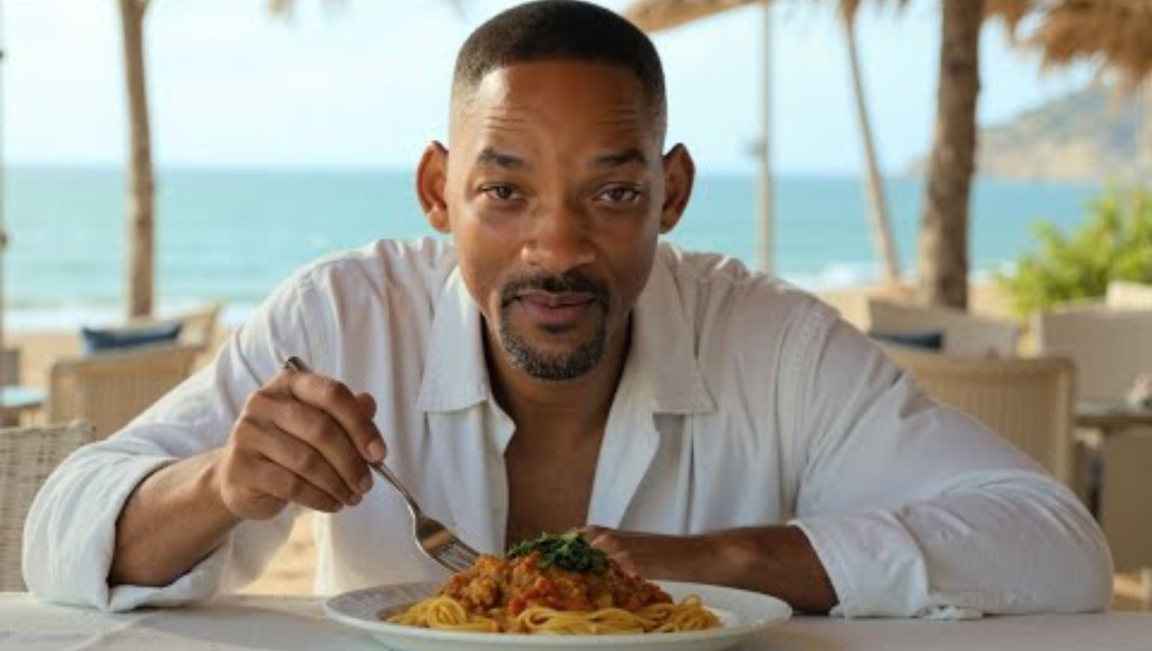
The Journey of AI Video Generation

Slide 16
Text, Video, Image...... and Audio!
Text to Speech
ElevenLabs
New AI Voices
AI Mimicking specific voices
Phone Calls
Retelli
Automated Secretaries, Receptionists, Tech Support, Q&A
Music
Suno
Completely new music
Create Jingles

Slide 17
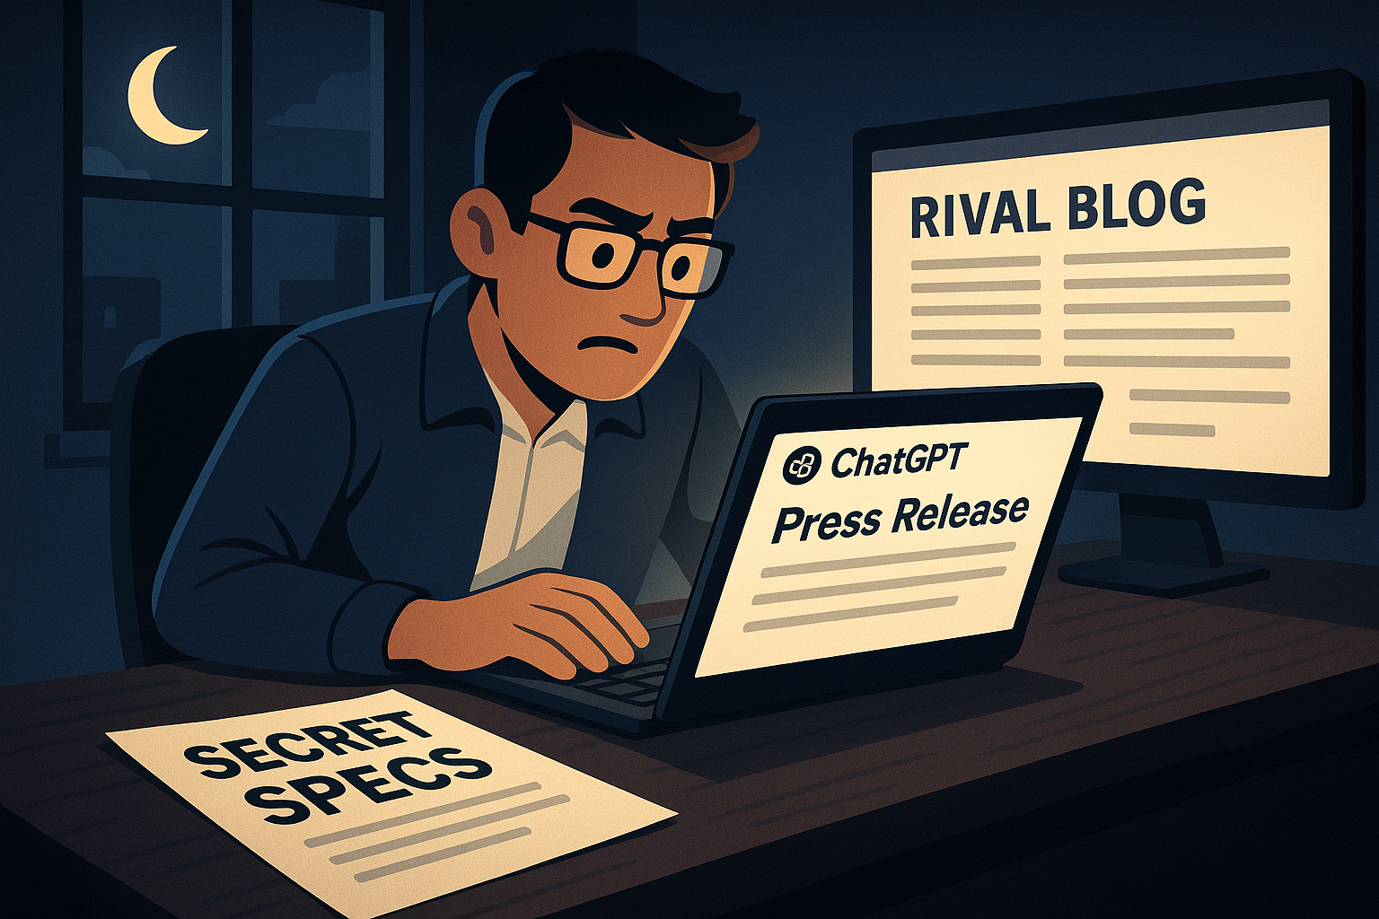
Ethical Scenarios: Employee Level
Scenario 1: Company Secrets
Late at night, a junior marketing associate pasted the secret specs for next quarter's flagship product into public ChatGPT to create a press release much faster then they could write one themselves. The models draft looks great, until a rival blog published similar details the following week. ChatGPT can and will train on data submitted by free accounts!
sora

Slide 18
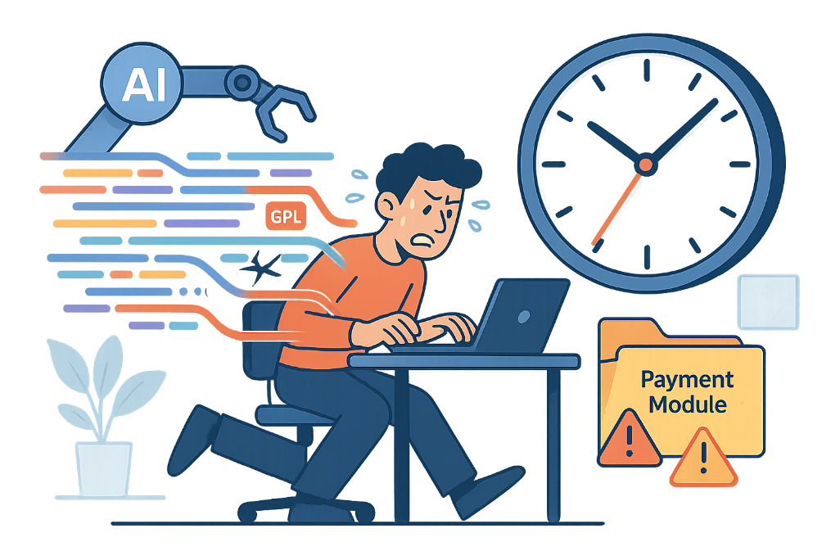
Ethical Scenarios: Employee Level
Scenario 2: Unvetted Code
Under intense deadline pressure from higher-ups, a developer let github copilot autogenerate a payment processing module and merged it without the usual license or security checks. Two months later, a routine audit revealed snippets lifted from GPL code and a latent vulnerability that exposed customer credit cards. One saved deadline has become a costly remediation nightmare.
sora

Slide 19
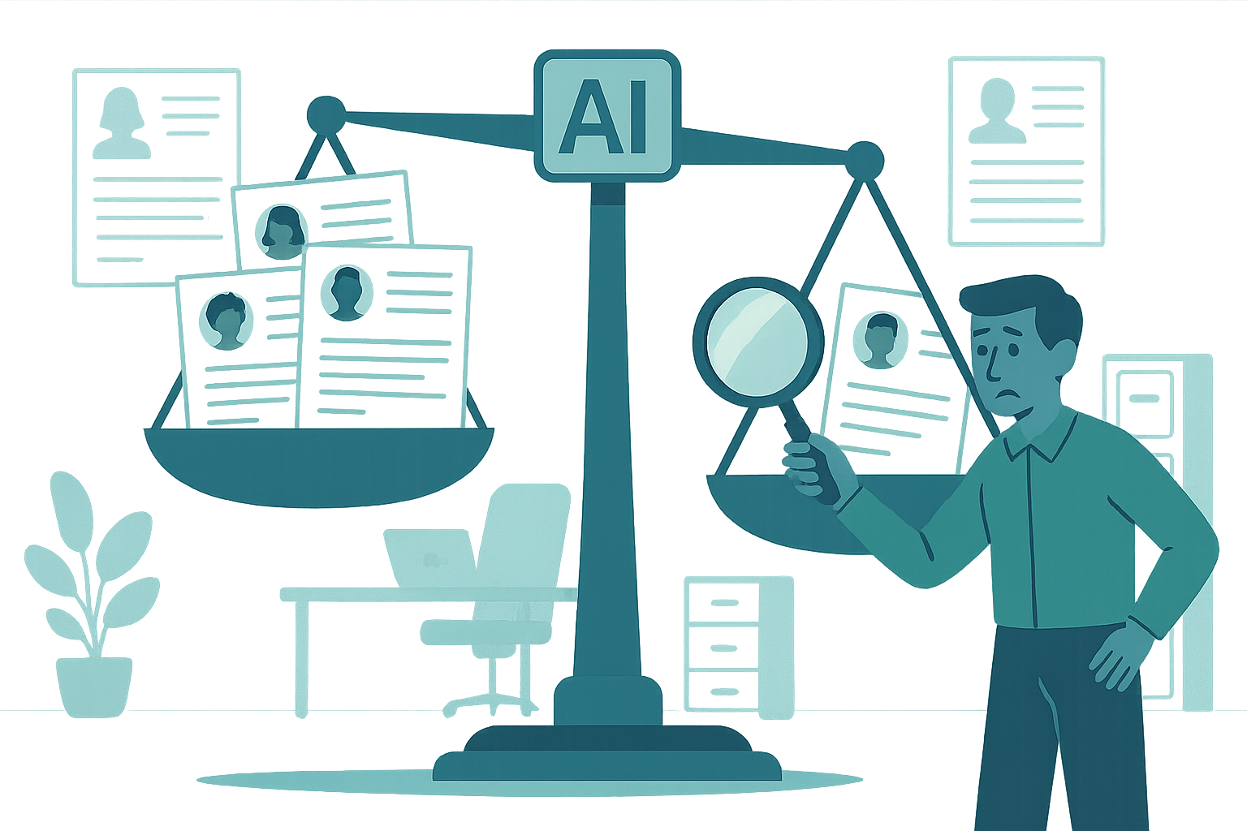
Ethical Scenarios: Company Level
Scenario 1: Algorithmic Bias Detection
Your company's HR department has implemented an LLM that assists with reviewing job applications. After several months, an employee notices that the system seems to prioritize candidates from certain educational and racial backgrounds and consistently ranks others lower, despite similar or even identical qualifications. If this gets out lawsuits will ensue for discrimination against protected class.
sora

Slide 20
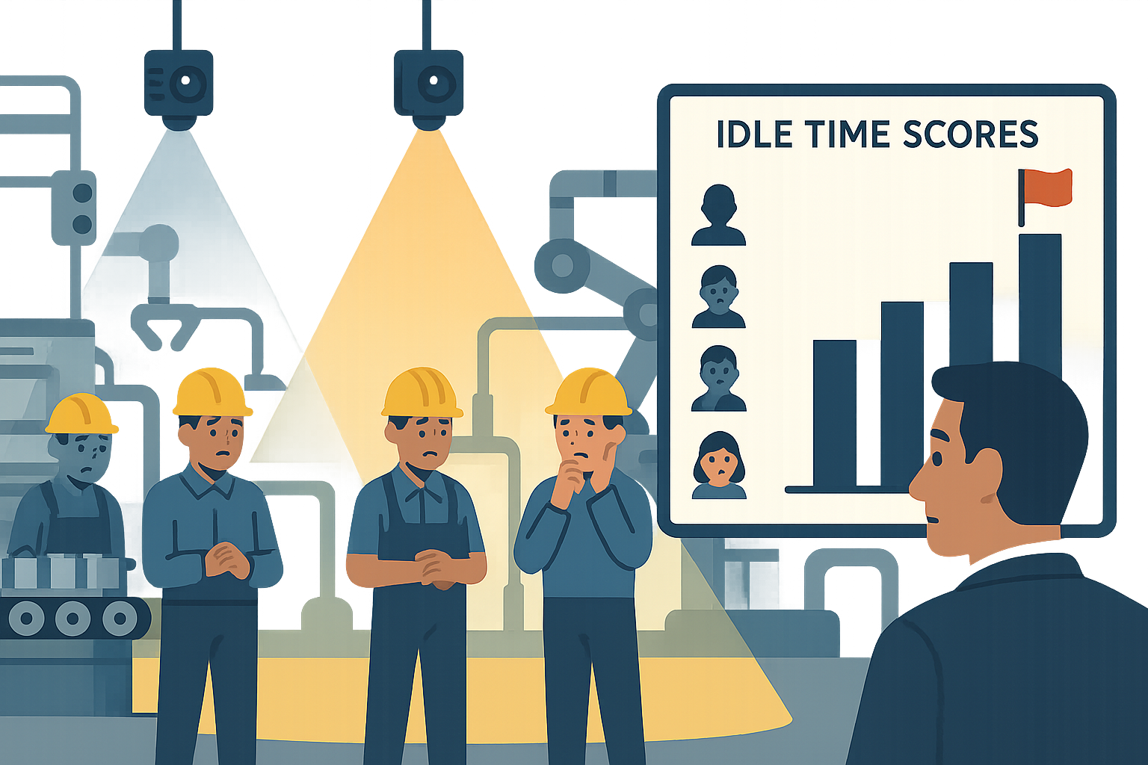
Ethical Scenarios: Company Level
Scenario 2: AI Workplace Surveillance Goes Too Far
Eager to boost efficiency, the executive team rolled out an AI powered camera system that supposedly just tracked safety incidents on the factory floor. Within weeks, the software began ranking individual "idle time" and piping the scores straight into the performance dashboards—leading managers to discipline staff for longer water-cooler chats. This triggered a huge drop in job satisfaction and a slew of workforce-wide privacy complaints that was quickly picked up by the press, becoming a national discussion-point.

Slide 21
Ethical Scenarios: Image Gen
Interactive: Please Imagine a CEO in your mind, or if you cannot, then please write down what "A CEO" looks like

Slide 22
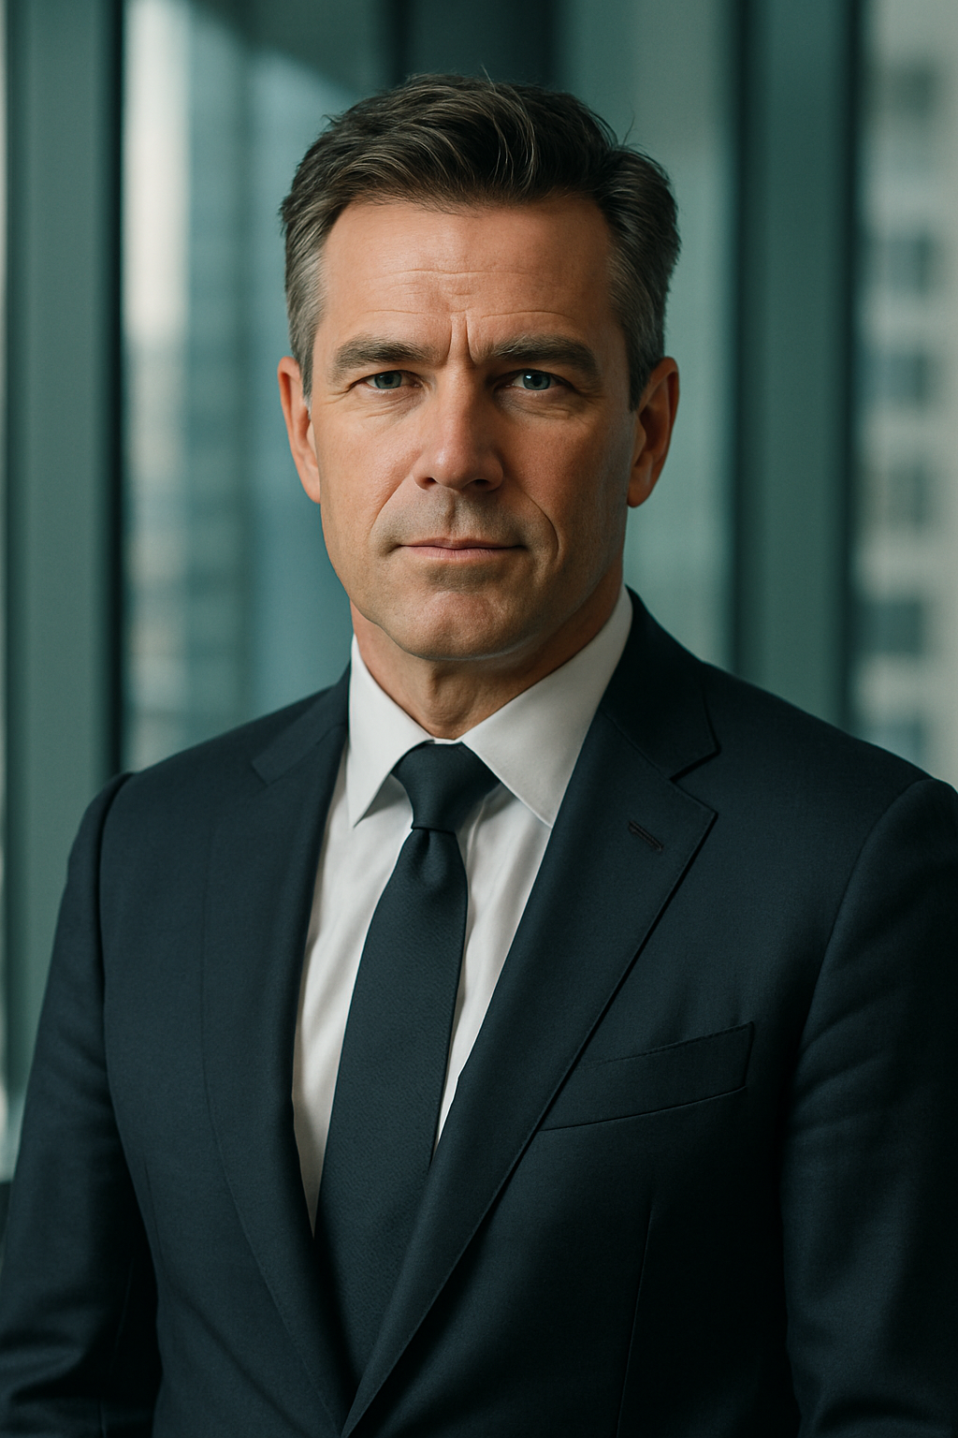



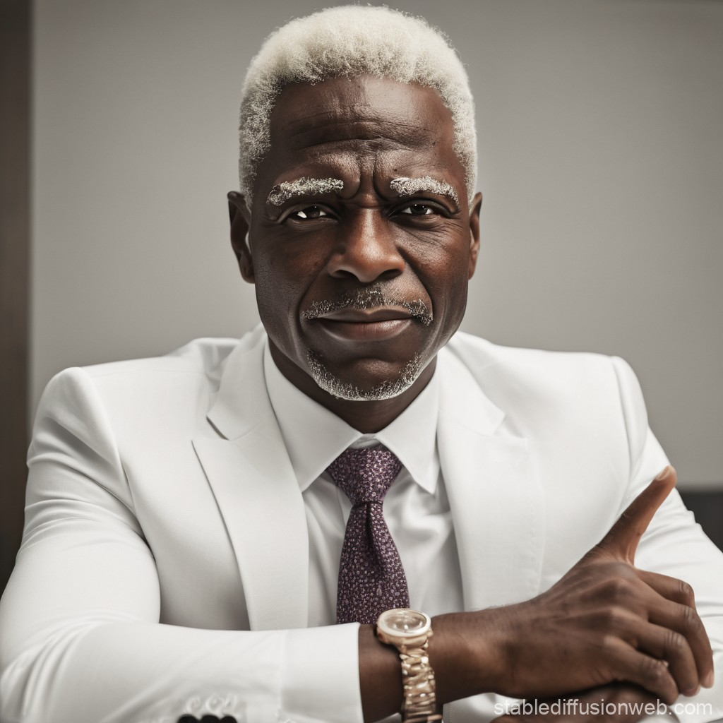
Ethical Scenarios: Image Gen and Bias
Scenario 1: AI Reflects the current state of the world and also sometimes the opinions of its creators
If you ask an image generator to make "A CEO" you get this
What do these images have in common?
Sora
Stable Diffusion
Gemini
Flux Schnell
Deep AI

Slide 23
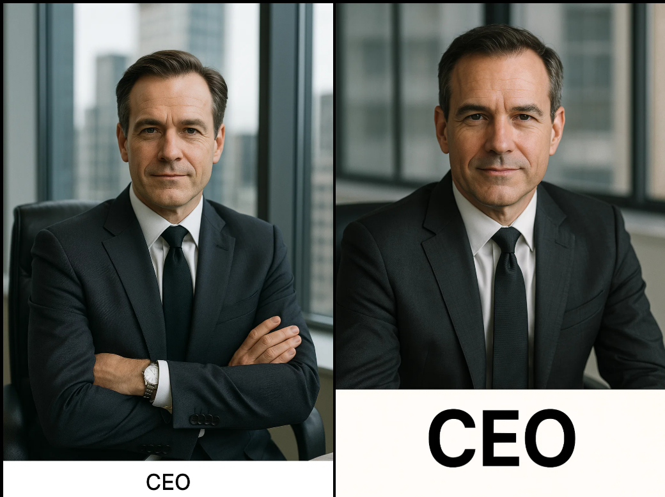
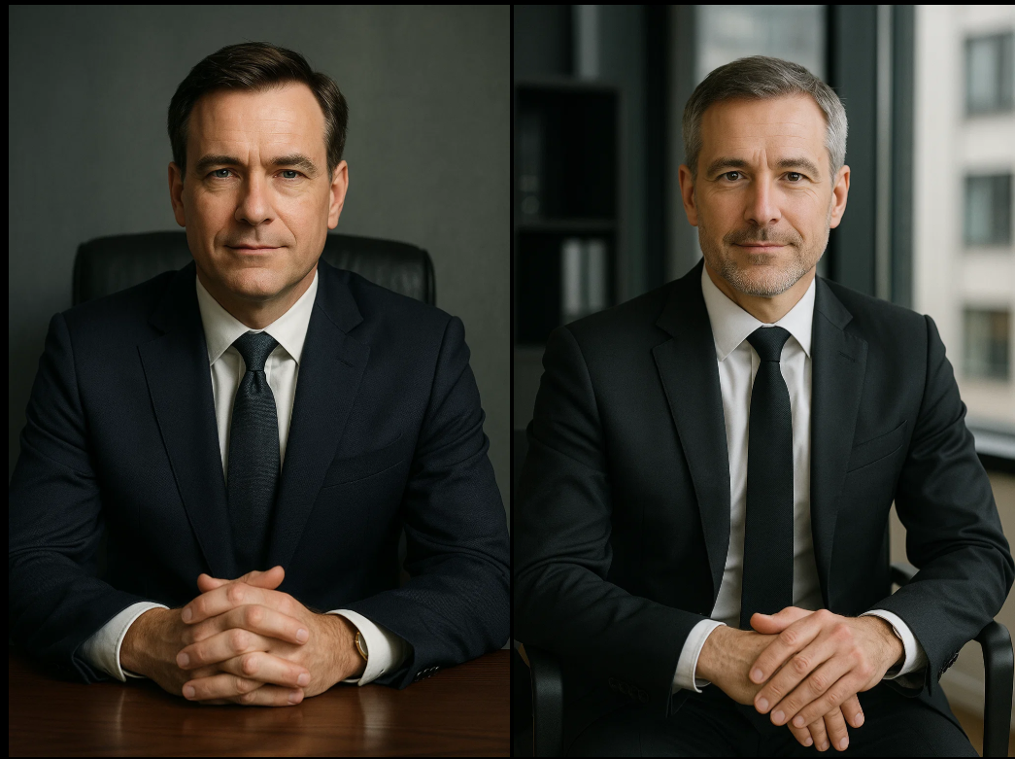
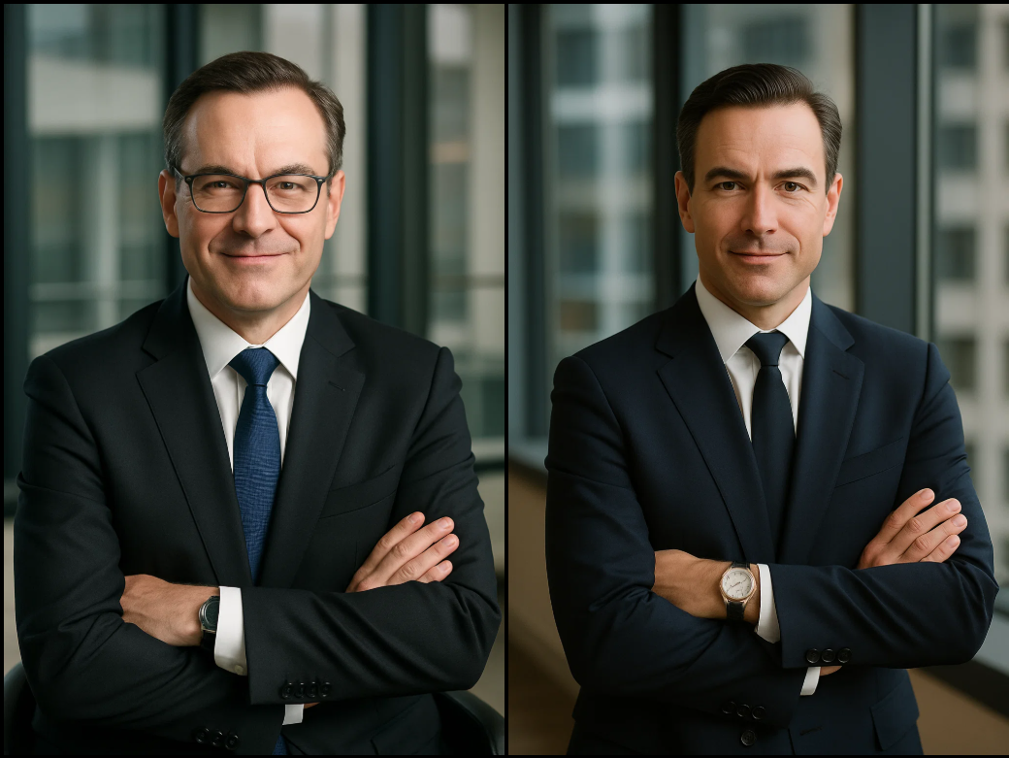
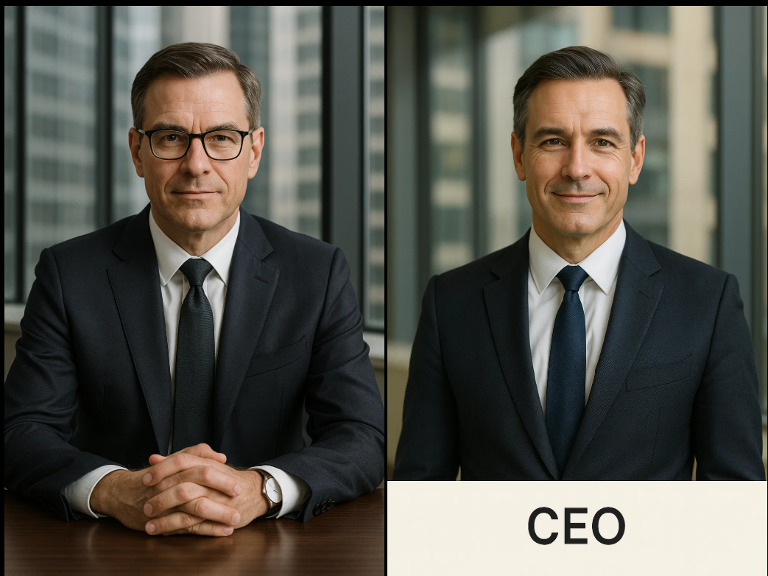
Ethical Scenarios: Image Gen and Bias
Scenario 1: Continued
As many times as you ask, it will not make a woman if you let it decide
Sora almost always gives you specifically a white man in a skyscraper in a black or blue suit

Slide 24
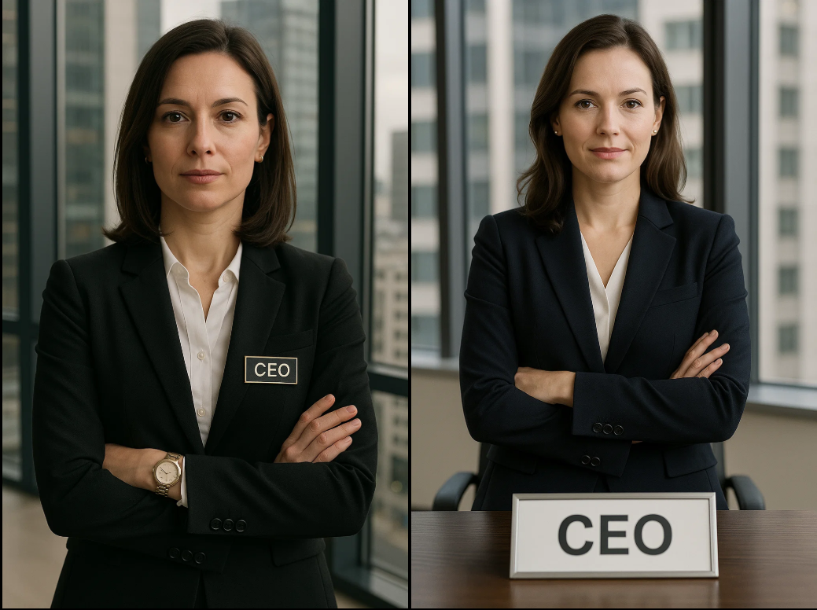



Ethical Scenarios: Image Gen
Scenario 1: Continued
"A Woman CEO"
Generates just fine when told explicitly.
Women (in American) as CEO's make up
10% Fortune 500
15% public companies
Ai Image Generation
Does not reflect this
100% men not 85-90%
Sora
Gemini
Stable Diffusion

Slide 25
Overcoming Objections
Please shout out what you’ve heard!

